Slide 1

High Reduction Self-Locking Perpendicular Transmission Blackbox
Machine drawing practice - PROJECT REPORT
S Tarun prasad – me17b114

Slide 2
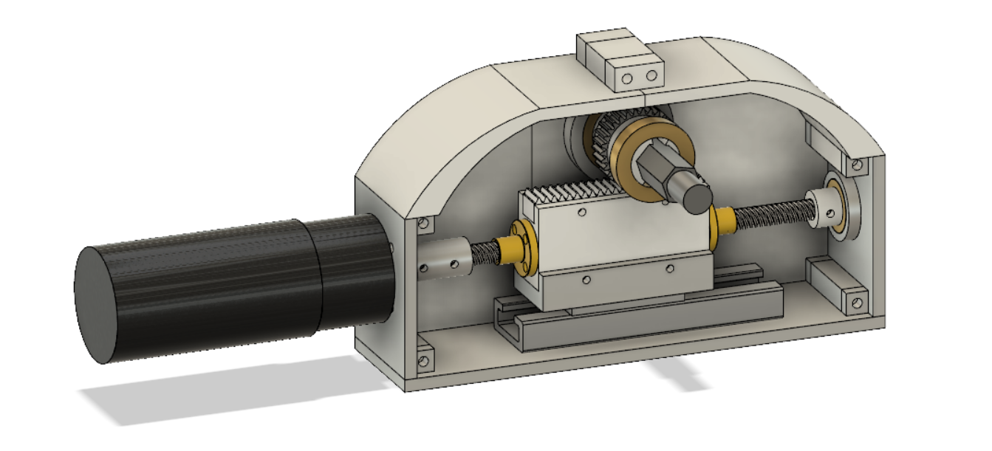
The Assembly:

Slide 3
Aim and Major Components:
To design a perpendicular high reduction self-locking transmission Blackbox.
Components Used:
1. Lead Screw 5. Rack-Nut-Guide Coupler
2. Lead Nut (2) 6. Rack
3. Rail 7. Pinion
4. Linear Guide 8. Hex-Shaft

Slide 4
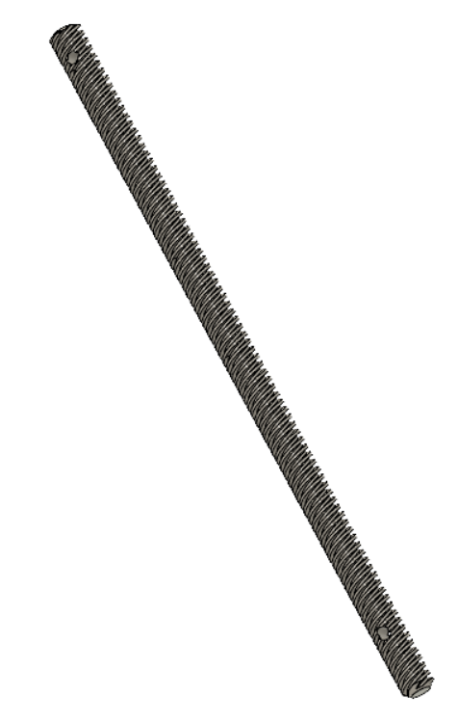
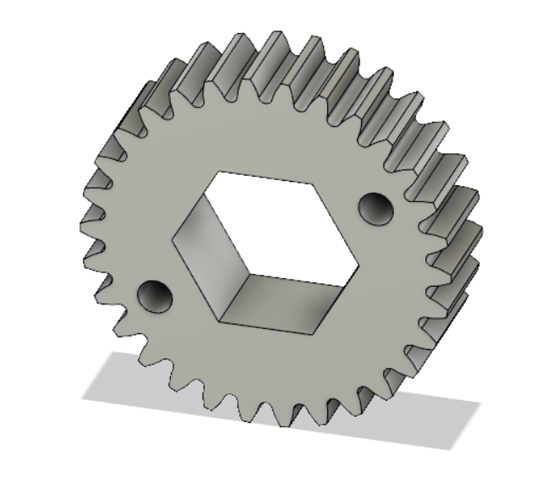
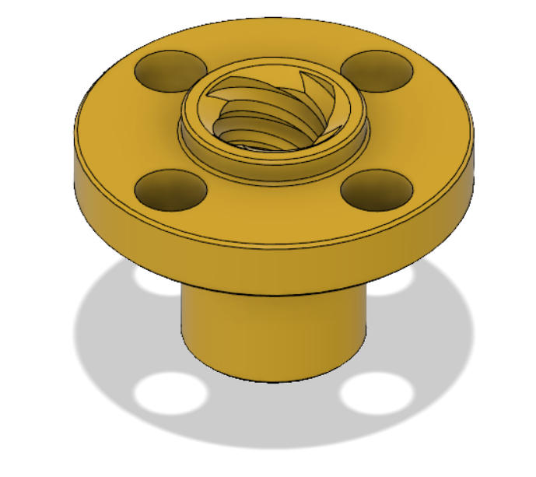
Components Used:

Slide 5
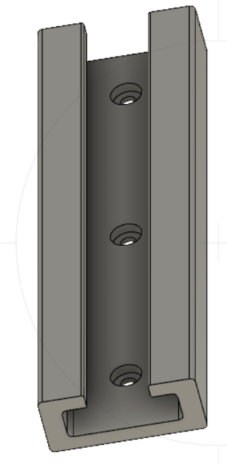
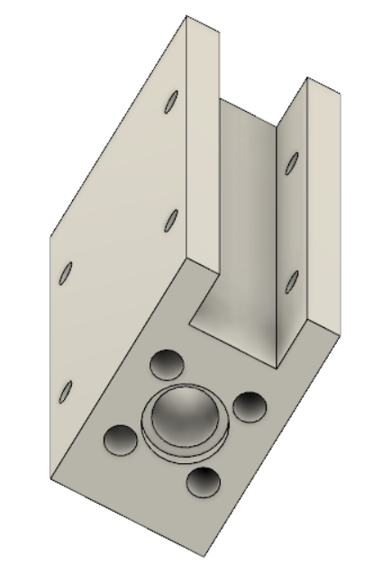
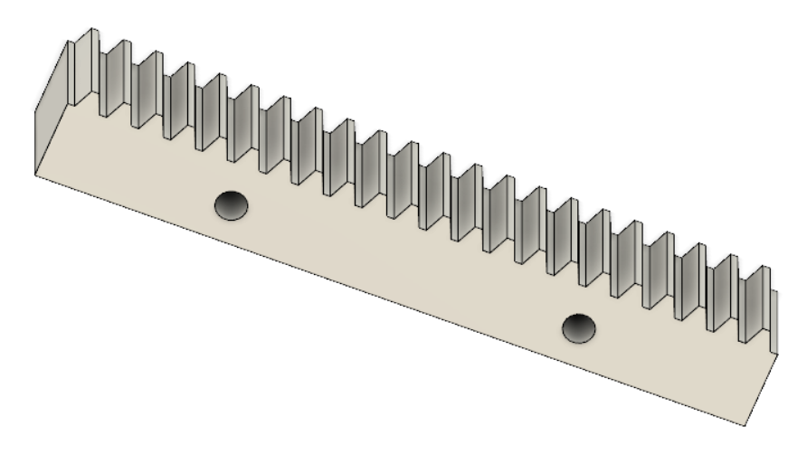
Components Used:

Slide 6
Uses:
Can be used in systems where a high reduction self locking joint is required.
Motor mounting need not be along the axis of the joint due to the perpendicular axis transmission offered by the blackbody.
Can be used in systems where continuous actuation is not a requirement and where optimum motion through a finite range is desired.

Slide 7
Mechanism:
Rack and Pinion gear transmission where the pinion is coupled to the Lead Nut on the Lead Screw.
The motor is coupled to the lead screw through a coupler which is mounted on the front plate via a bearing. The other end of the lead screw is supported by a bearing on the backplate.
The lead nut is coupled to the part which connects to both the rack and the linear guide which can slide on the rail on the base plate.
The rack meshes with the Pinion which is supported by bearings on the side plates with the help of the hexagonal shaft coupled to the pinion.

Slide 8
Motion:
When the motor powers the lead screw, it rotates and the nut translates thus moving the rack which rotates the pinion.
The high reduction is achieved via the nut motion on the lead screw which also makes the transmission self-locking.

